Slide 1
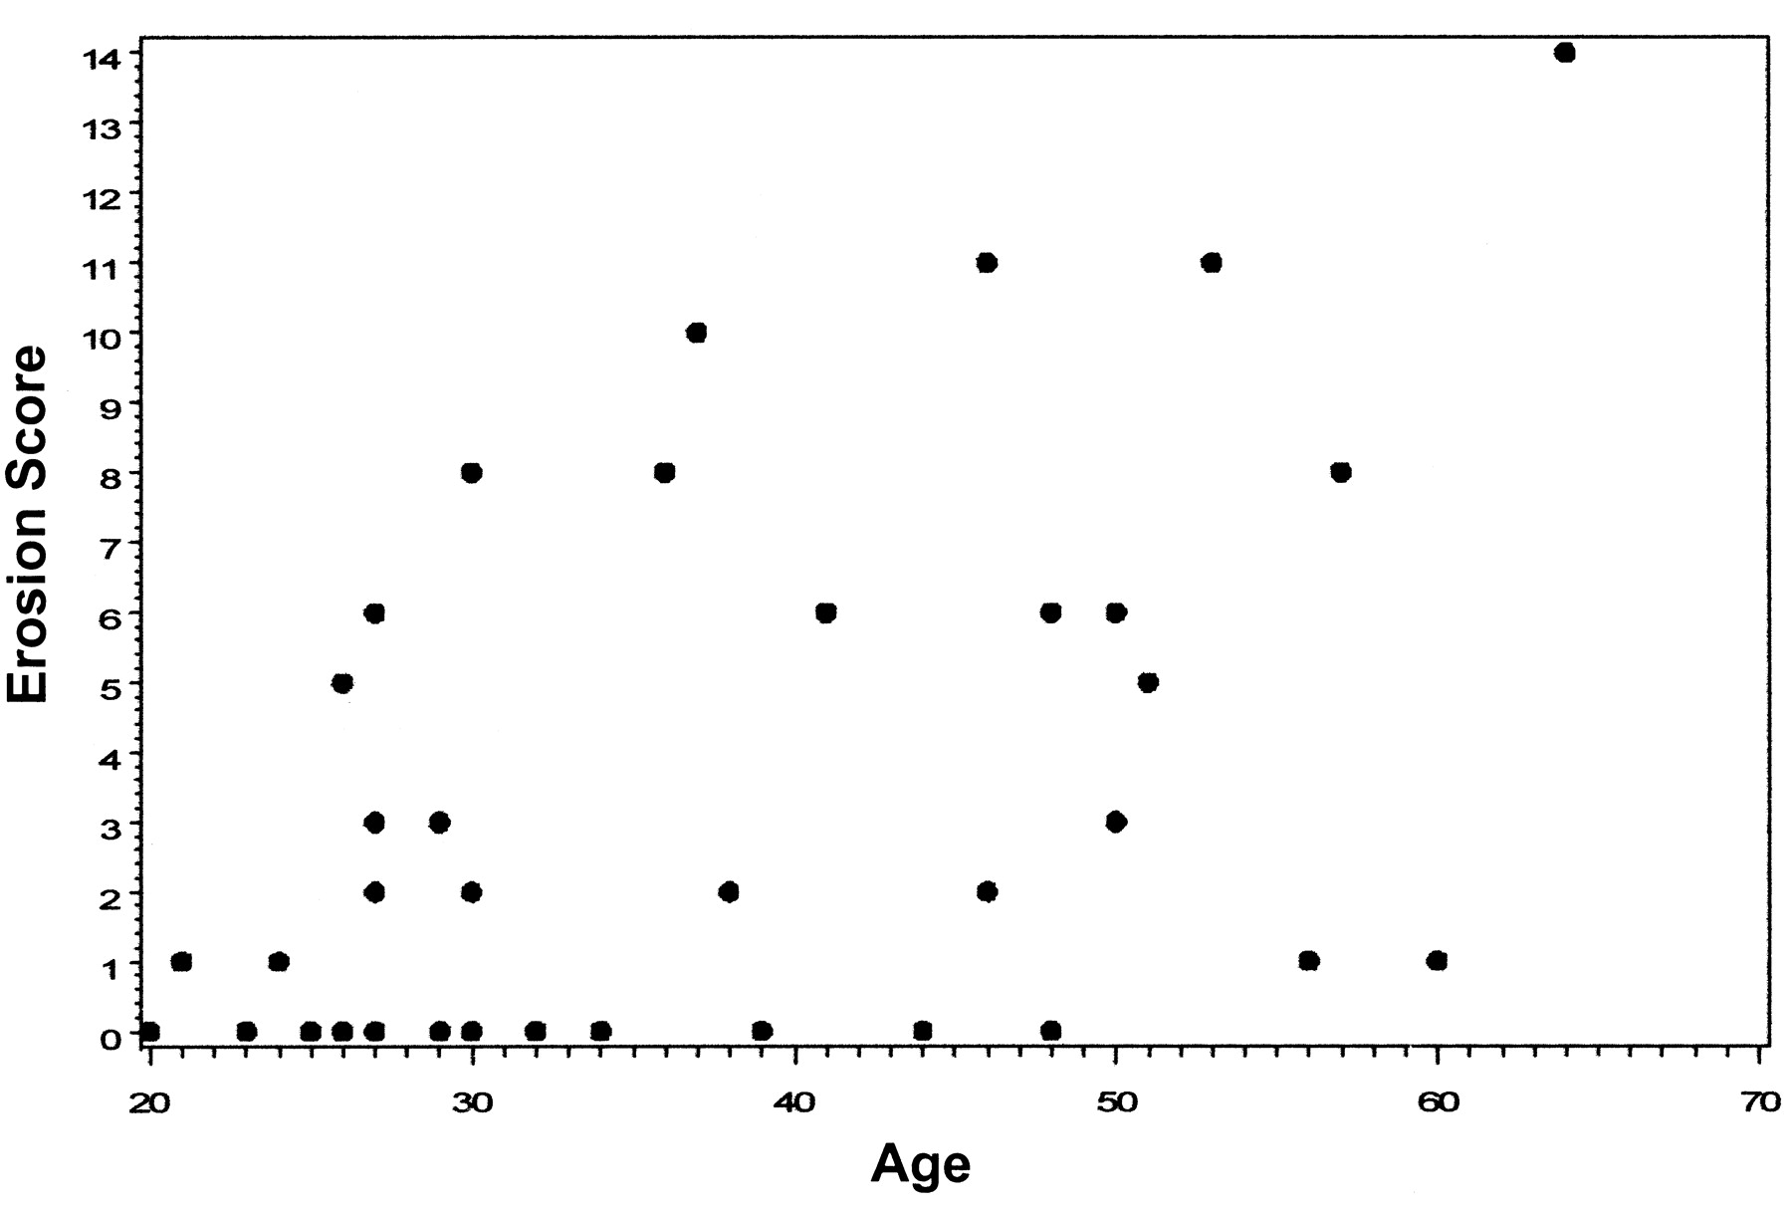

Plot of total erosions score by age in healthy controls (correlation coefficient = 0.47, p < 0.01).
EWA OLECH et al. J Rheumatol 2010;37:265-274
Notes:
Plot of total erosions score by age in healthy controls (correlation coefficient = 0.47, p < 0.01).

