Slide 1
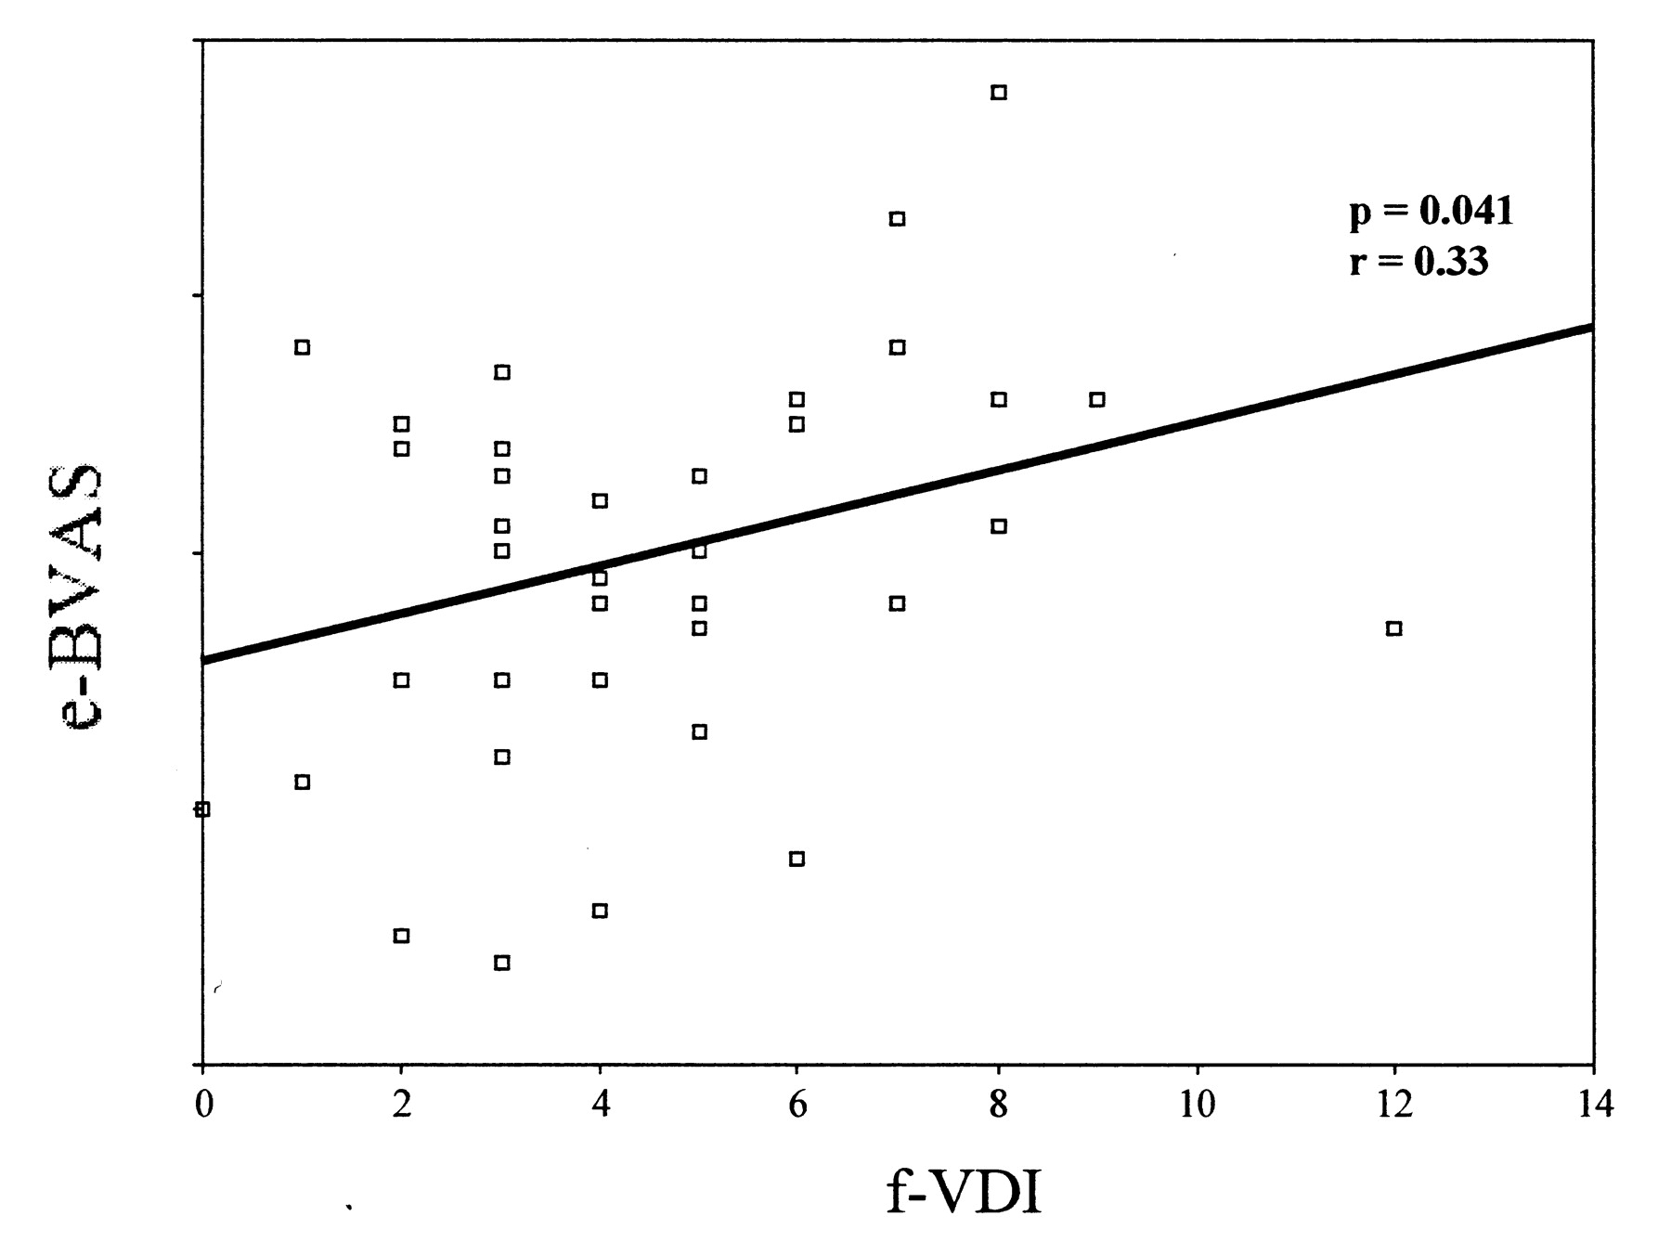

Correlation of early Birmingham Vasculitis Activity Score (e-BVAS) and final Vasculitis Damage Index (f-VDI) scores.
SEVIL KAMALI et al. J Rheumatol 2010;37:374-378
Notes:
Correlation of early Birmingham Vasculitis Activity Score (e-BVAS) and final Vasculitis Damage Index (f-VDI) scores.

